Slide 1
How to split test and train data set

Slide 2
The train-test split is a technique for evaluating the performance of a machine learning algorithm. It can be used for classification or regression problems and can be used for any supervised learning algorithm. The procedure involves taking a dataset and dividing it into two subsets.

Slide 3
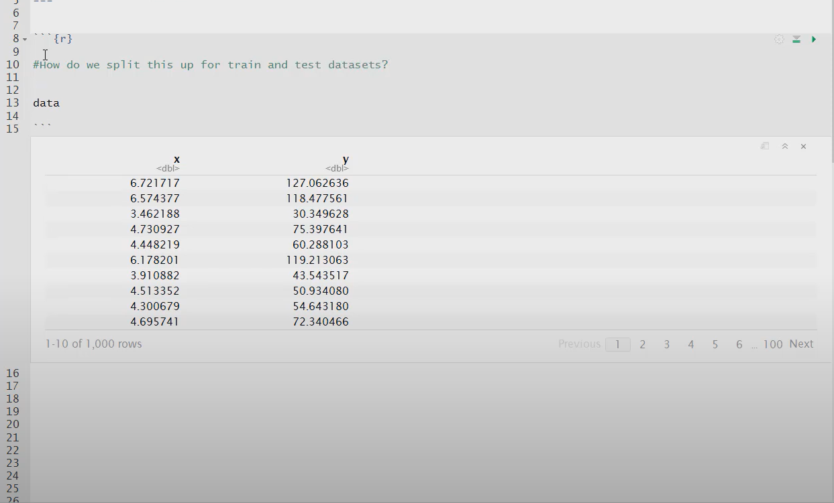
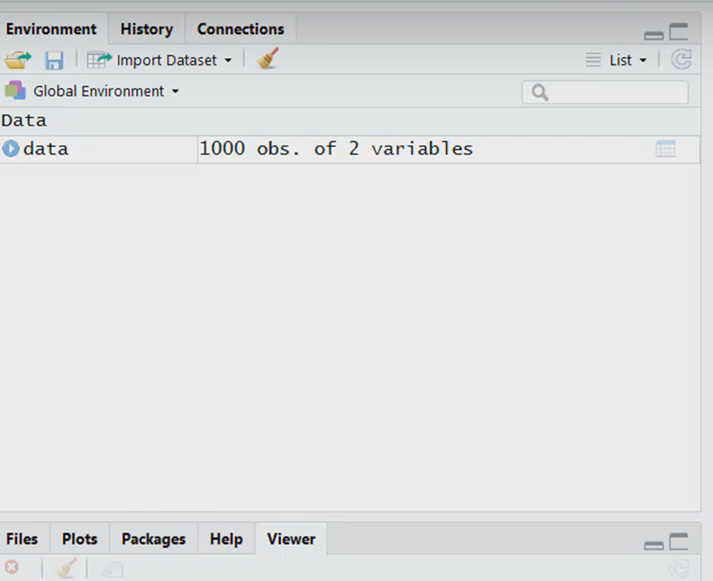

Slide 4
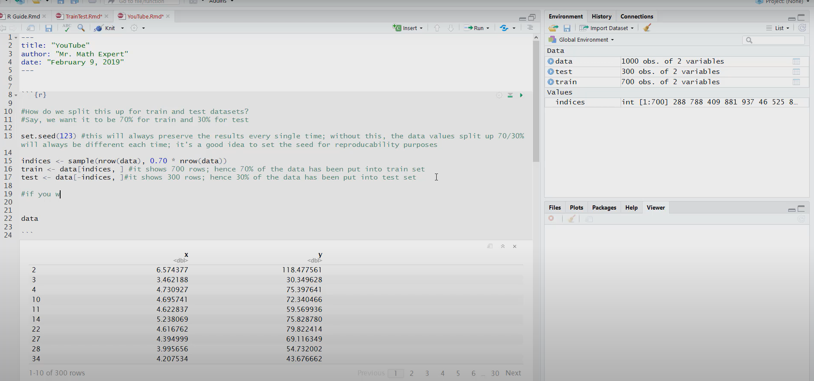
We want to split 70% for train and 30% for test data

Slide 5
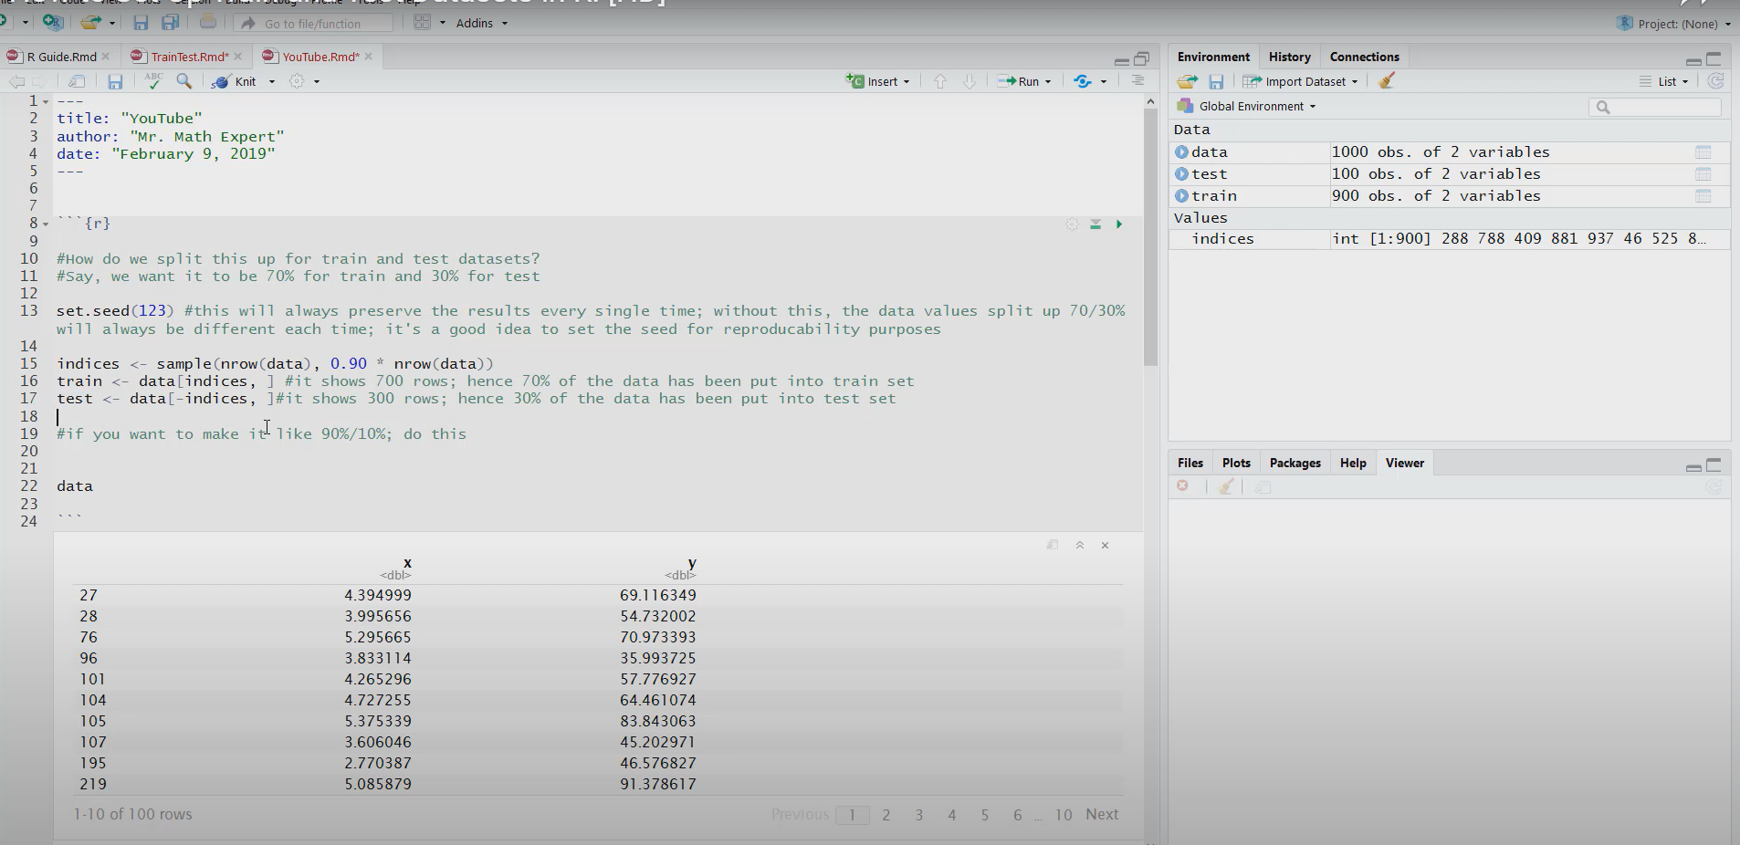
We want to split 90% for train and 10% for test data

